Slide 1

TOXIC COMMENT CLASSIFICATION
P316- Group : 3
Radhika Atre
Dr. Renu Maan
Bolladi Sujith Kumar
Sidrah Kareemunnisa
Ritik Sunil Parate
Syed Imaduddin
Mentor: Mr. Madishetti Rajshekar

Slide 2
PROBLEM STATEMENT & BACKGROUND
Given dataset is a collection of comments, given by users on a Wikipedia page. The objective is to build a classification model to make predictions and provide sentiment analysis of an input comment . The problem is a multiclass classification problem with the following target classes.
TOXIC
SEVERE TOXIC
OBSCENE
THREAT
INSULT OR IDENTITY HATE

Slide 3
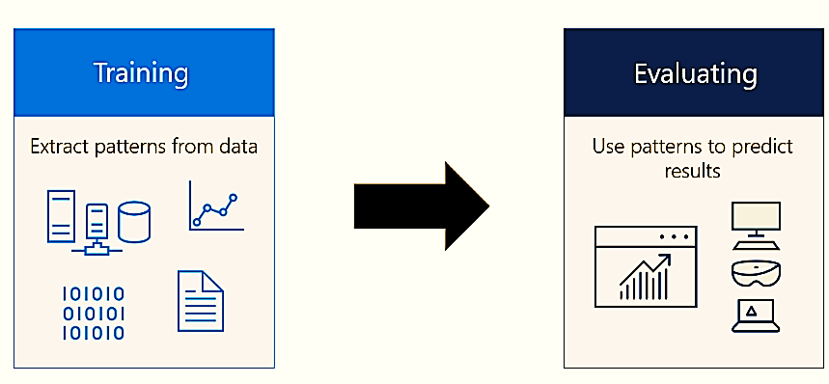
PROJECT MILESTONES
Week 1 : EDA
Week 2 : Model Building
Week 3 : Model Evaluation
Week 4 : Deployment

Slide 4

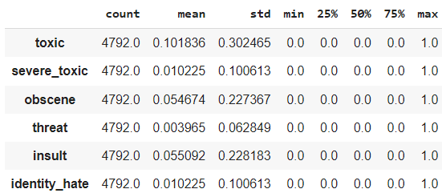
EXPLORATORY DATA ANALYSIS
Originally there were 164094 rows & 8 columns.
Dropped Data Duplicates.
Dropped all the Null Values.
Dropped all the having non-numeric entries for the labels.
Created a new column named ‘Toxicity’ to show multilabelling.
Changed the data types of all labels.

Slide 5
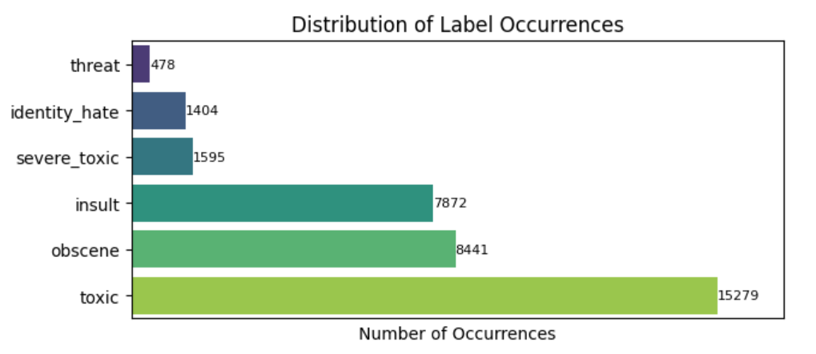
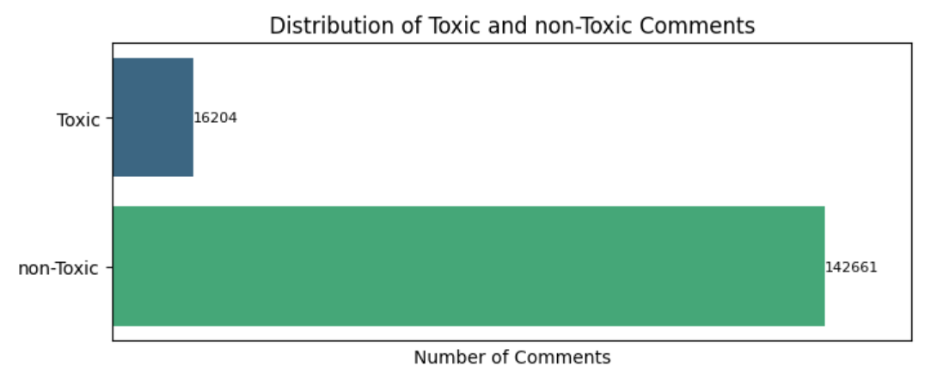
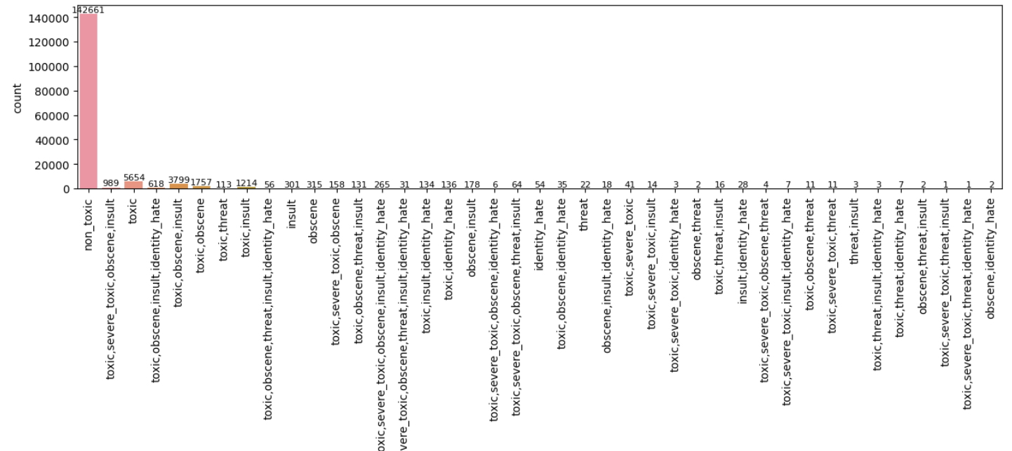
EDA

Slide 6
Conclusions from the Data Preprocessing
The data is imbalanced, as there are about 88% comments that are non-toxic.
The problem comes under the multilabel, binary classification as a comment can have multiple labels.
So we performed model building with and without data resampling. In order resample the dataset to balance the dataset, we took random samples from the non toxic data to match the size of toxic data.

Slide 7
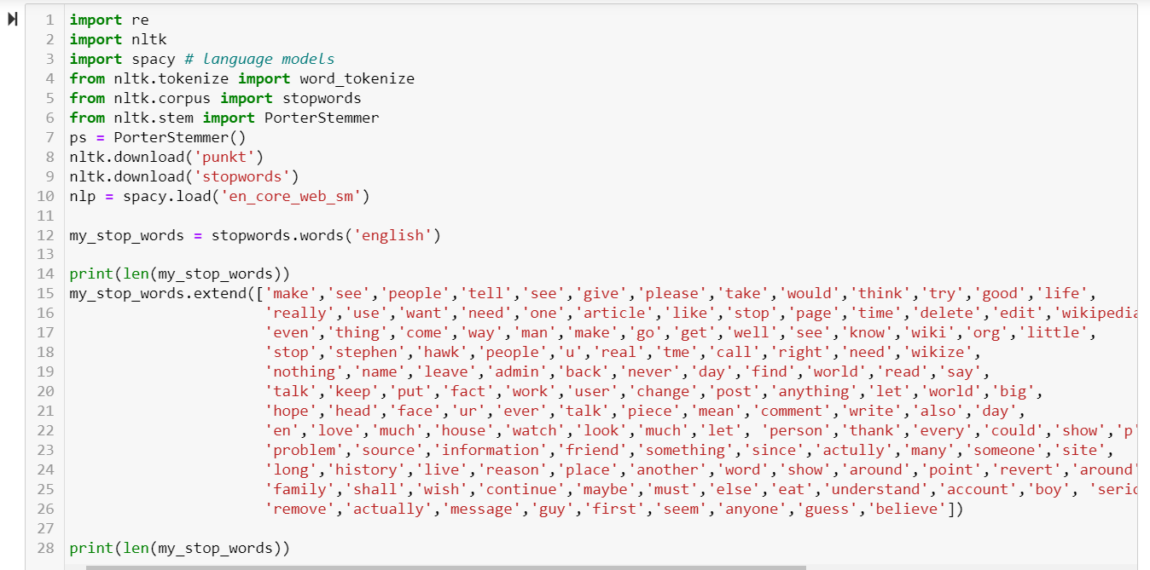
Text cleaning

Slide 8
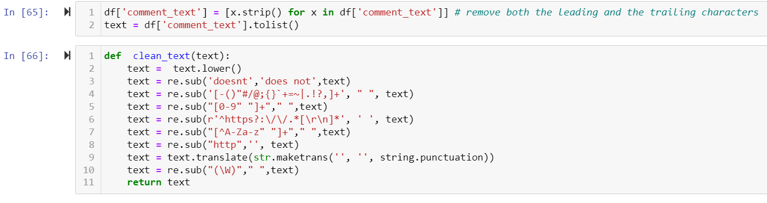
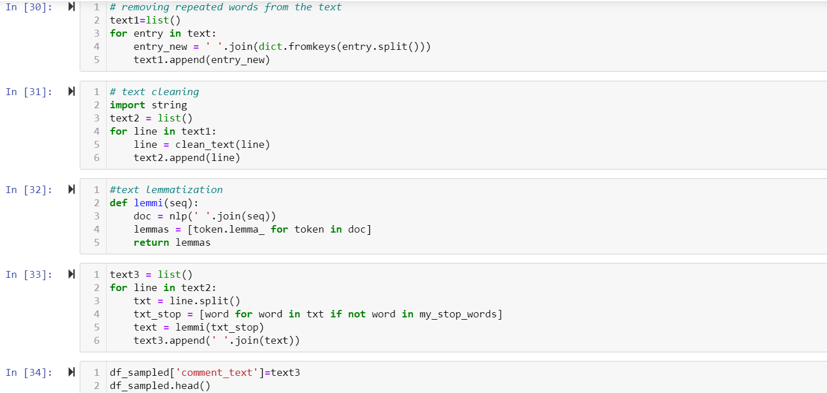
Text cleaning

Slide 9
Conclusions from the Data Preprocessing
The data is imbalanced, as there are about 88% comments that are non-toxic.
The problem comes under the multilabel, binary classification as a comment can have multiple labels.
So we performed model building with and without data resampling. In order resample the dataset to balance the dataset, we took random samples from the non toxic data to match the size of toxic data.

Slide 10
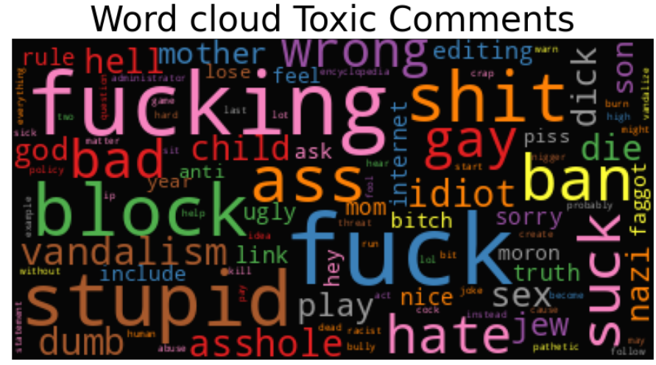
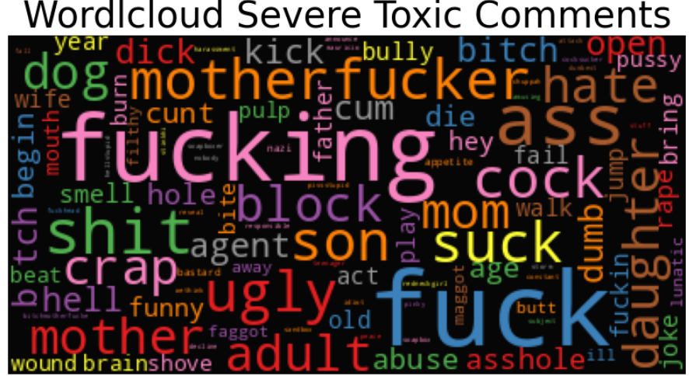
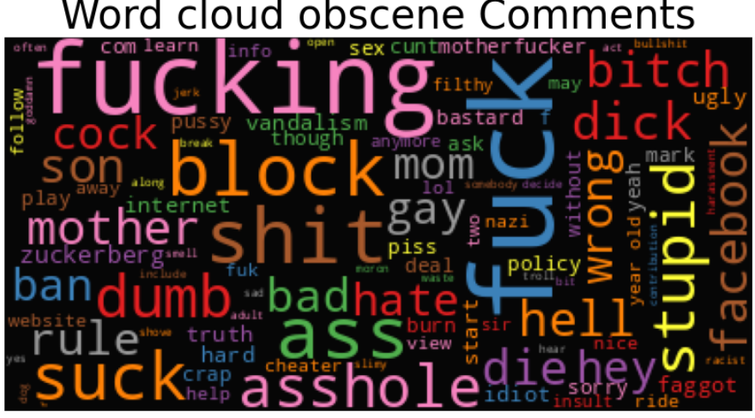
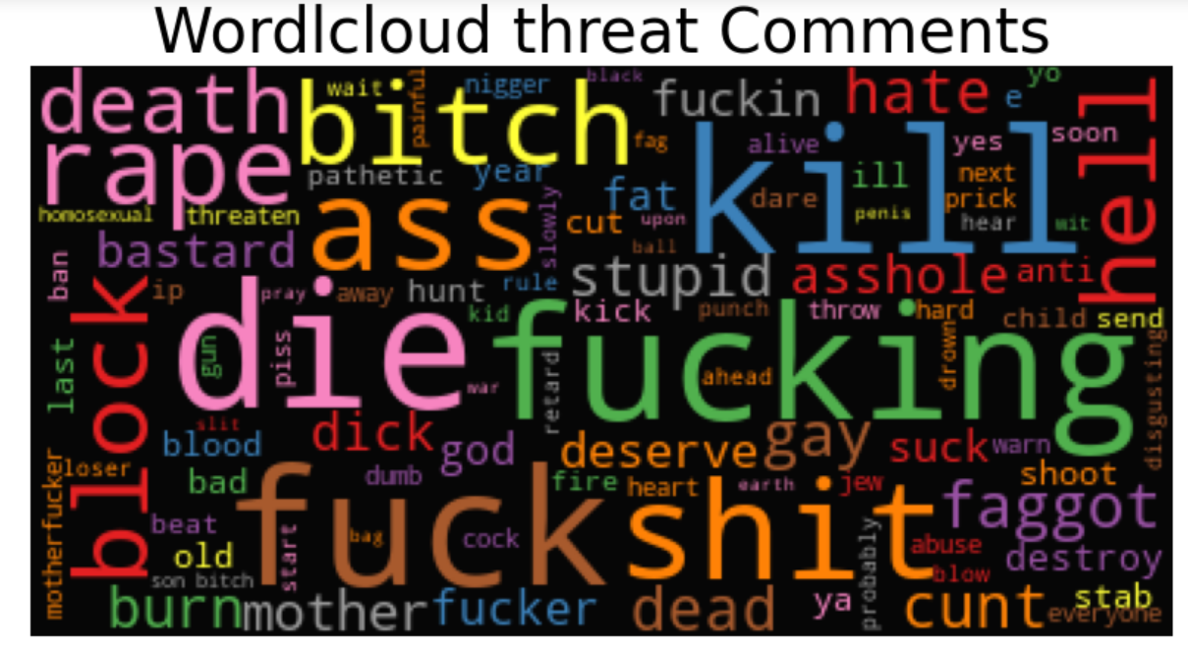
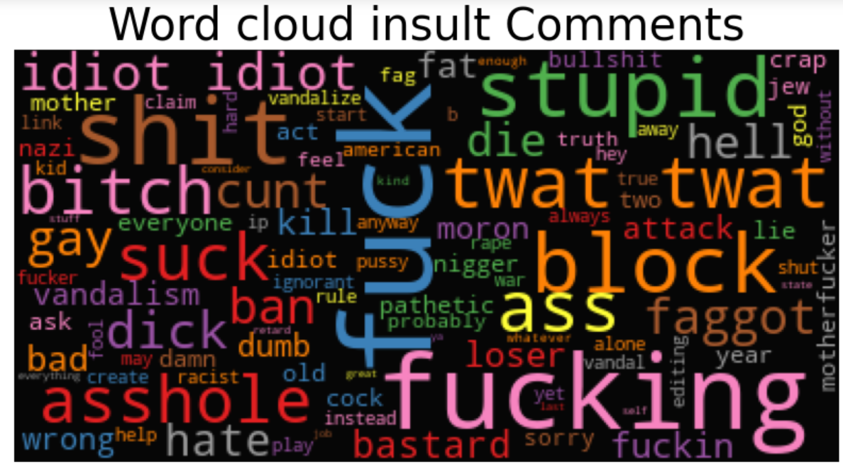
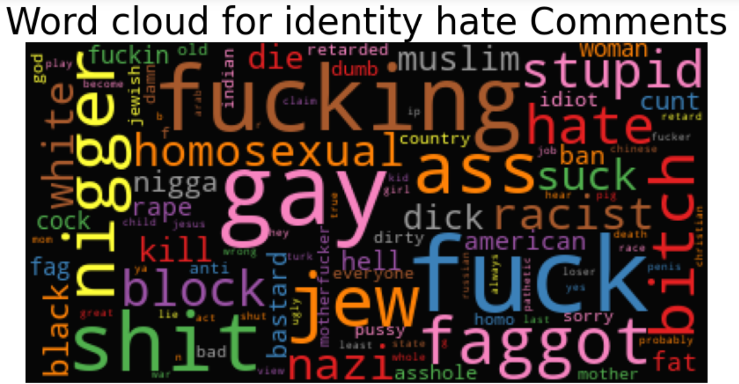
VISUALIZATON THROUGH WORD CLOUD

Slide 11
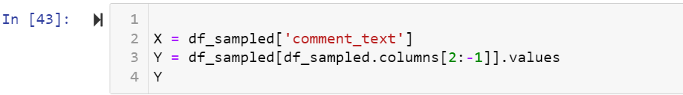
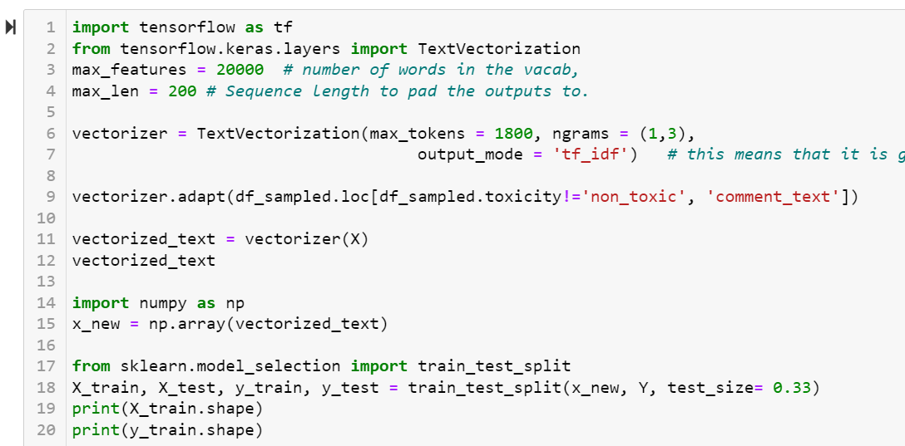
DATA SPLITTING & FEATURE EXTRACTION

Slide 12
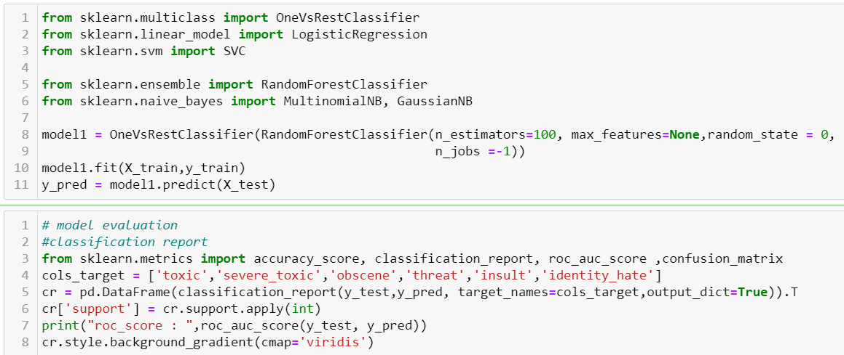
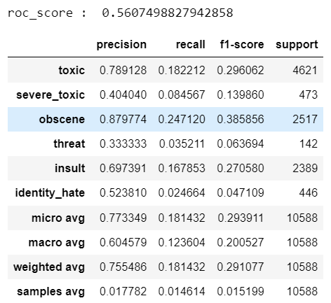
MODEL BUILDING
ONEVSRESTCLASSIFIER with Random Forest as the base model

Slide 13
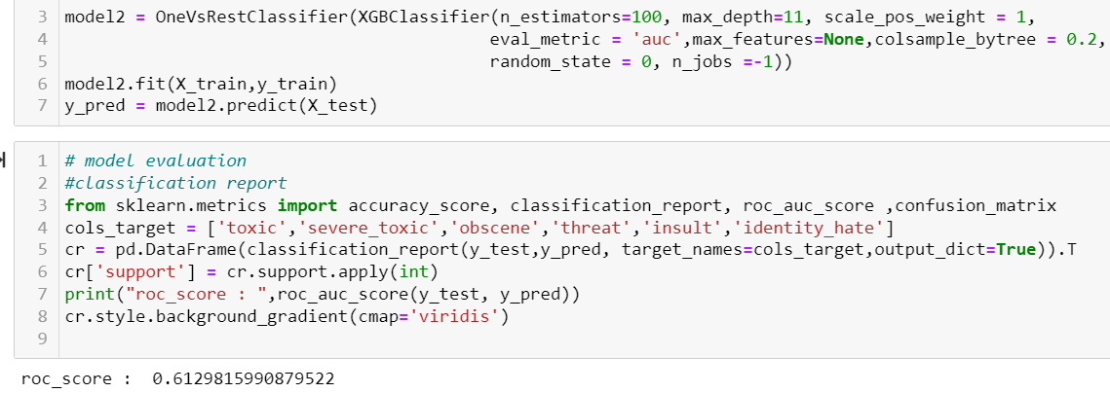
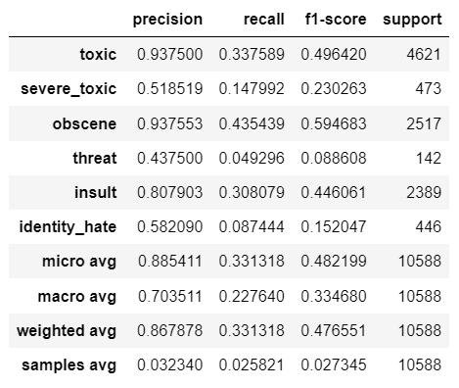
MODEL BUILDING
ONEVSRESTCLASSIFIER with XGBoost as the base model

Slide 14
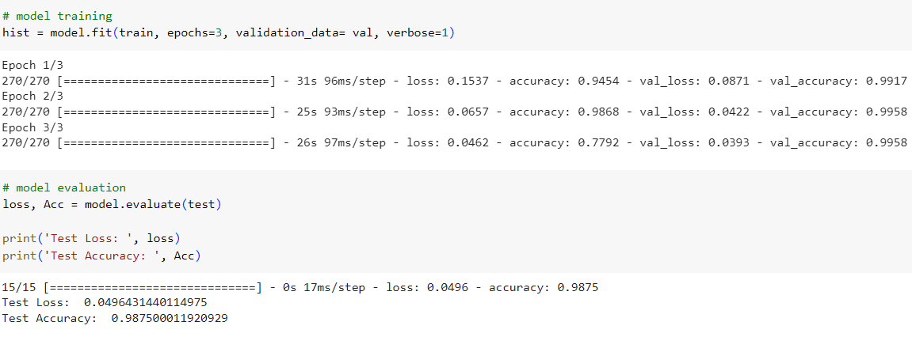
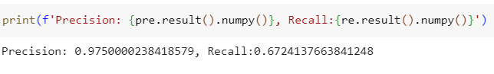
MODEL BUILDING
LSTM

Slide 15
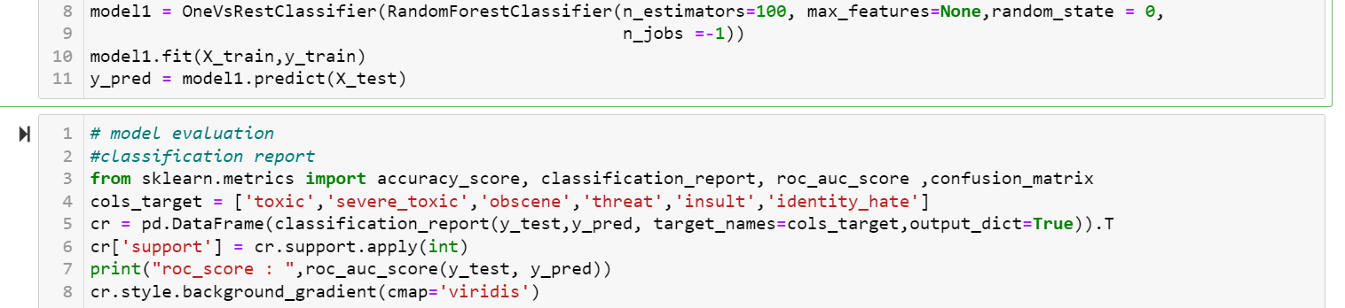
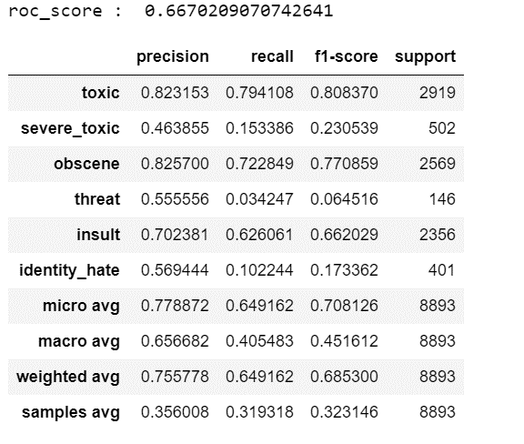
MODEL BUILDING after Resampling
ONEVSRESTCLASSIFIER with Random Forest as the base model

Slide 16
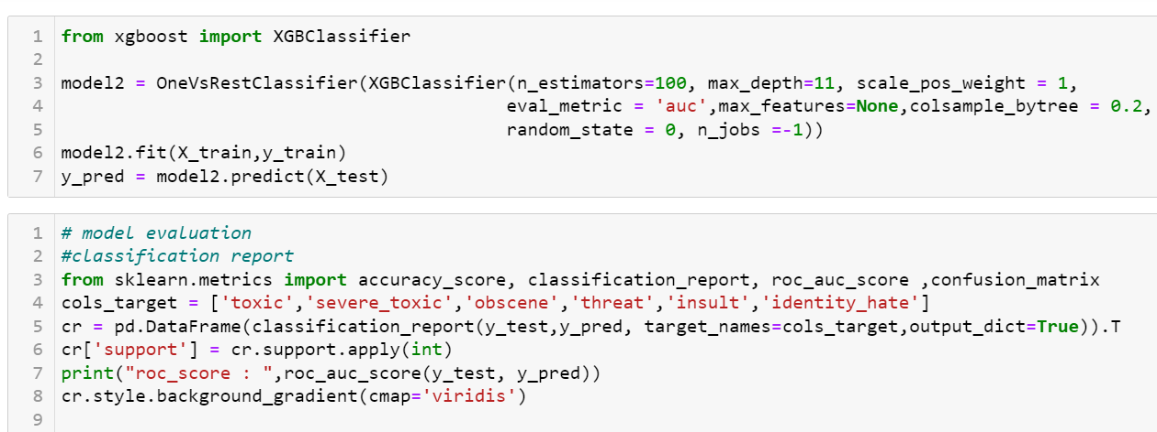
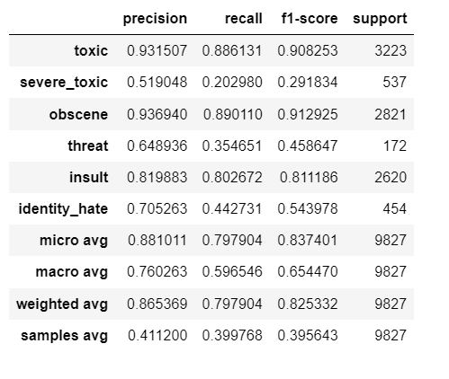
MODEL BUILDING after resampling
ONEVSRESTCLASSIFIER with XGBoost as the base model

Slide 17
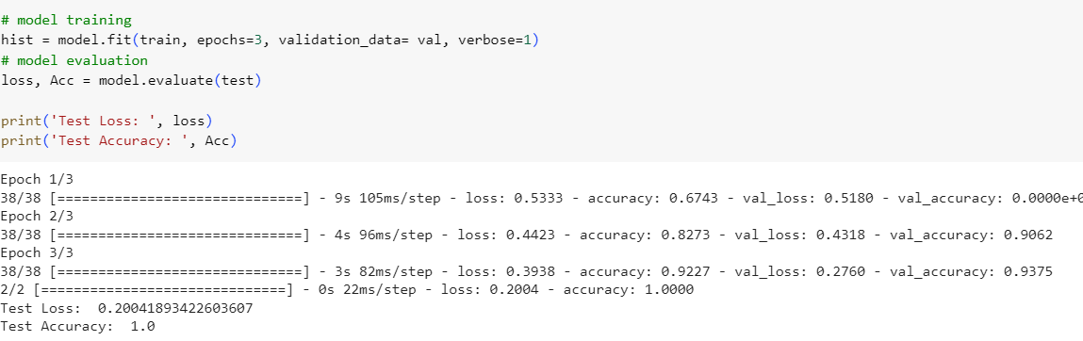
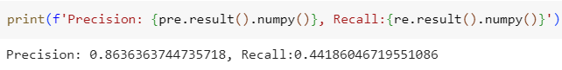
MODEL BUILDING after resampling
LSTM

Slide 18
Conclusions after model building
With onevsrestclassifier, XGBoost as the estimator gave best performance.
For a better performance tf-idf was found to be the best text vectorization method.
Resampling of data to balance the target classes was needed to achieve a good performance.
Since with LSTM the precision increased but the recalled decreased with resampled data, we chose onevsrestclassifer with XGBoost classifier as our final model.

Slide 19
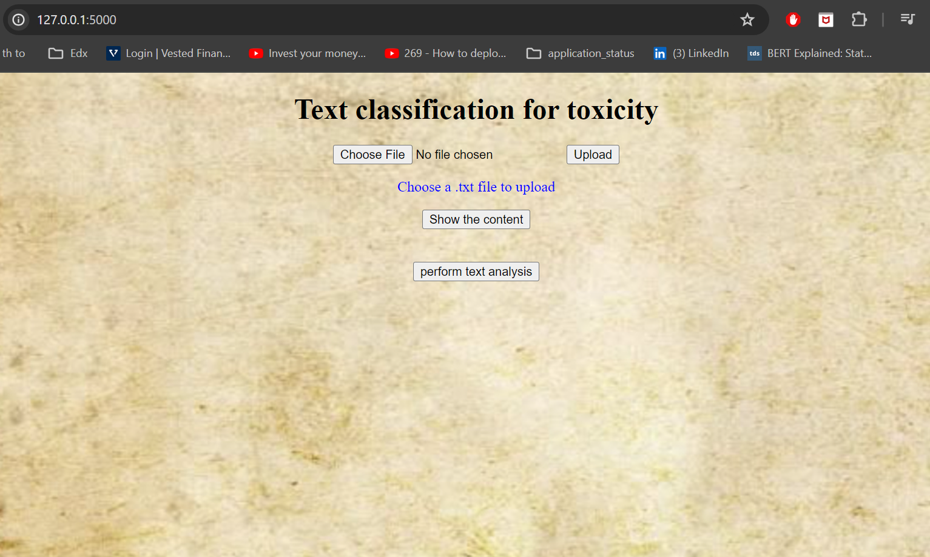
Model Deployment using FLASK
The first page we encounter on the local host gives the possibility of uploading a text file

Slide 20
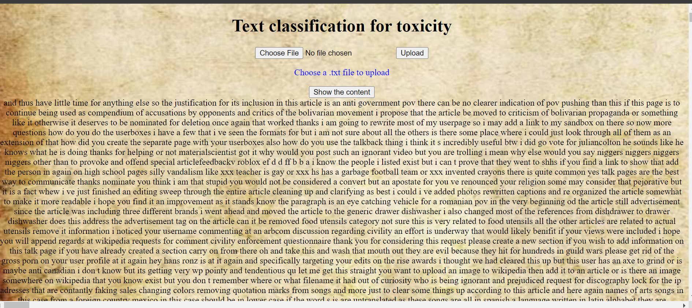
Conclusions after model building
After uploading the file one can click on the “show the content” to have a glimpse of the text

Slide 21
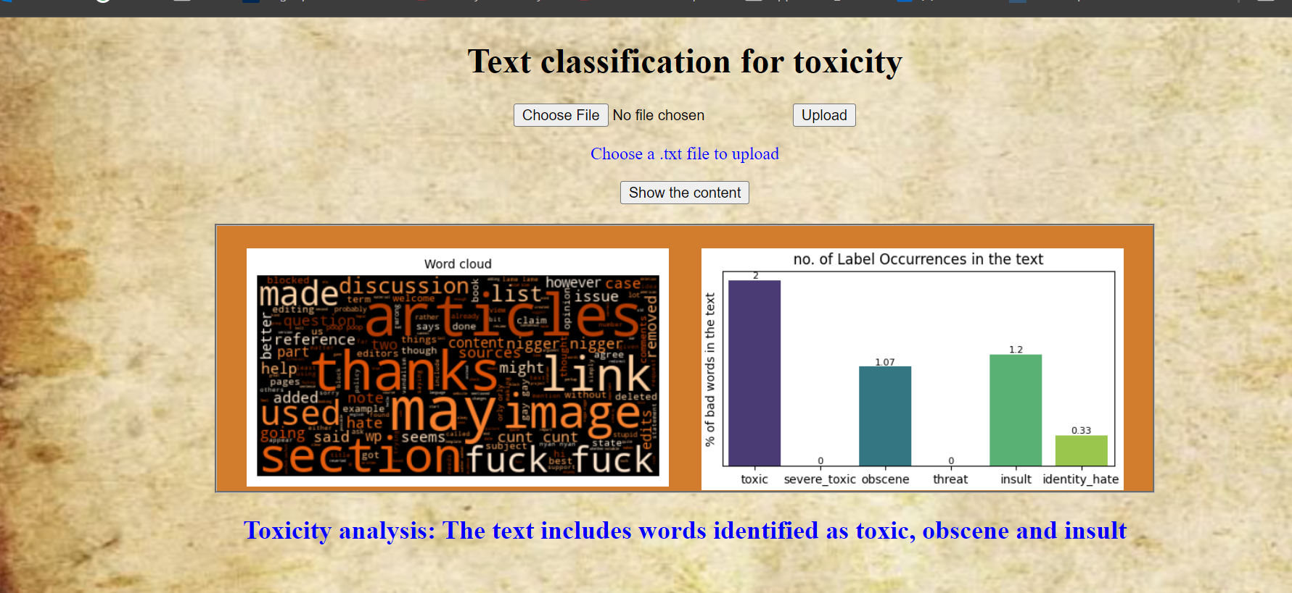
Conclusions after model building
Clicking on “Analyse the text” gives a word cloud and a bar plot showing the distribution of the toxic words present in the text.
Text analysis in blue gives the overall result of the analysis.

Slide 22
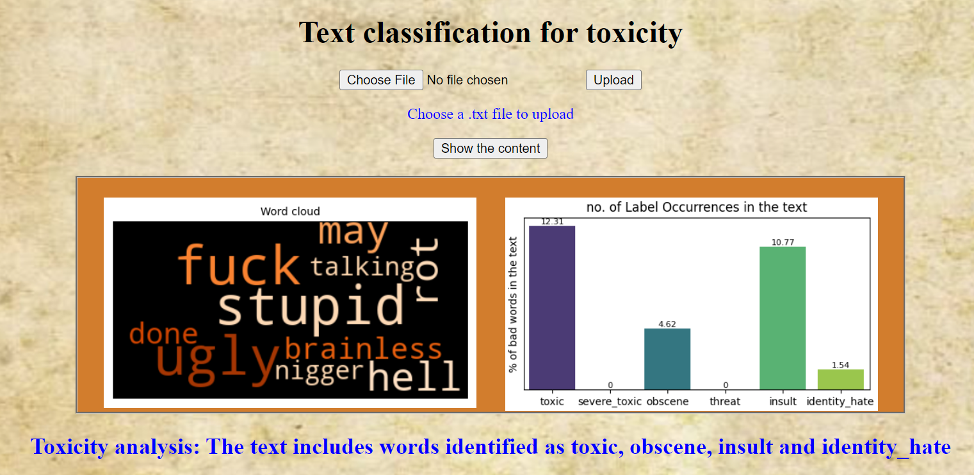
Conclusions after model building
Clicking on “Analyse the text” gives a word cloud and a bar plot showing the distribution of the toxic words present in the text.
Text analysis in blue gives the overall result of the analysis.

Slide 23
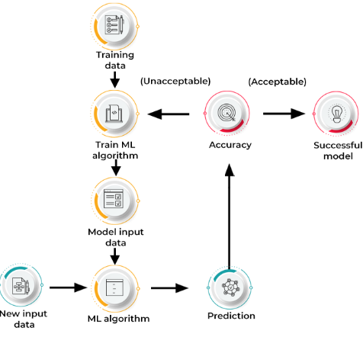
THANK YOU!

